Slide 1
MIMIC3 Admissions Data
Victor Treaba

Slide 2
Understanding death
With admission data, the main goal is to better understand the process through which a patient has undergone
Understand what circumstances they were brought under
Find correlations between their treatments and conditions compared to the outcome
Hope to gain a better understanding on what the chances of specific outcomes are based on patient circumstances
From there, try to determine remediation steps

Slide 3
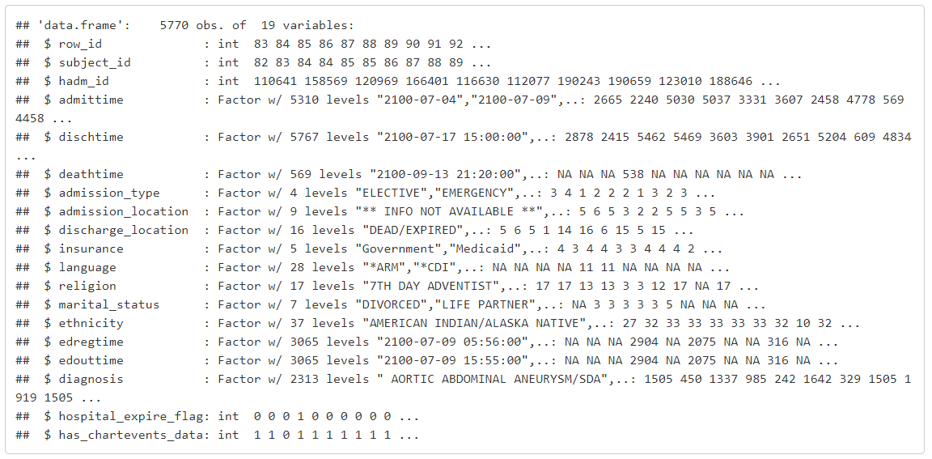
Data Format
5770 Rows with 19 Columns
Mostly Categorical data with few continuous variables.
Few factors have NA in them, should they be discarded?

Slide 4
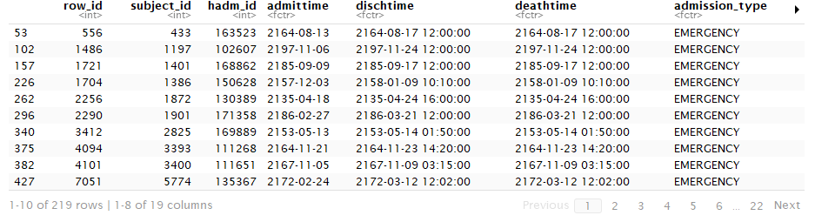
Understanding the data
Using na.omit(DATA) we can remove rows with NA to see how the data is affected by the presences of NA.
Reduces data set to only 219 rows
NA has a meaning rather than just signifying missing data.

Slide 5
When to NA
NA occurs prominently as factors for the following variables:
Deathtime - NA if didn’t die
Language - NA doesn’t make much sense
Marital_status - NA doesn’t make much sense
Edregtime - NA if not admitted to Emergency
Edouttime - NA if not discharged from Emergency

Slide 6
Continuous variables
Row_id - Row in table
Subject_id - Unique patient
Hadm_id - Unique hospital admission
Hospital_expire_flag - Did patient die 1/0
Has_chartevents_data - Electronic chart entries 1/0
Continuous variables aren’t that useful

Slide 7
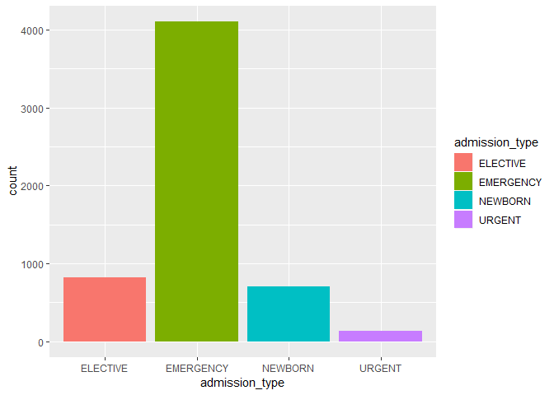
Admission Types
Data is skewed to Emergency types
Why is Emergency so frequent compared to others?
Accidents happen frequently
When people are sick, they generally would take care of it themselves first without visiting a doctor. In emergencies, can’t do this

Slide 8
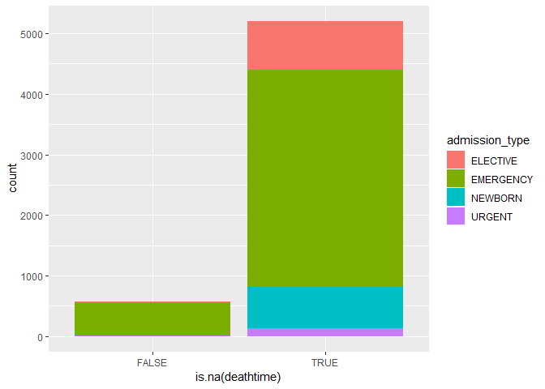
Where does Death occur?
Narrowing down on where deaths occur
Most death occur in Emergency type admissions
Emergency type admissions are the ones with the most severe problems, so this makes sense

Slide 9
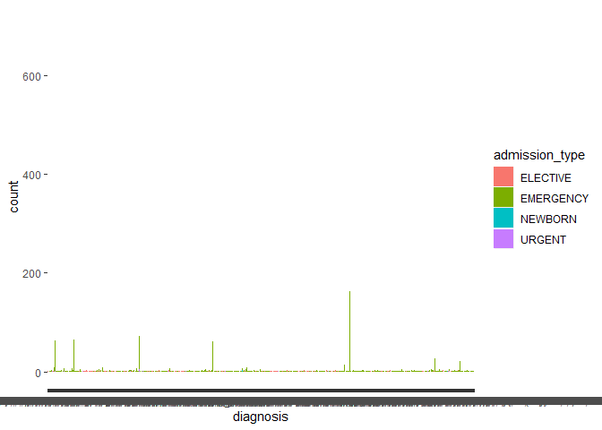
Why do people get admitted?
Even though it’s a categorical variable with thousands of levels, we can plot it to see trends
Reveals there are conditions that are most frequent
Isolate these?

Slide 10
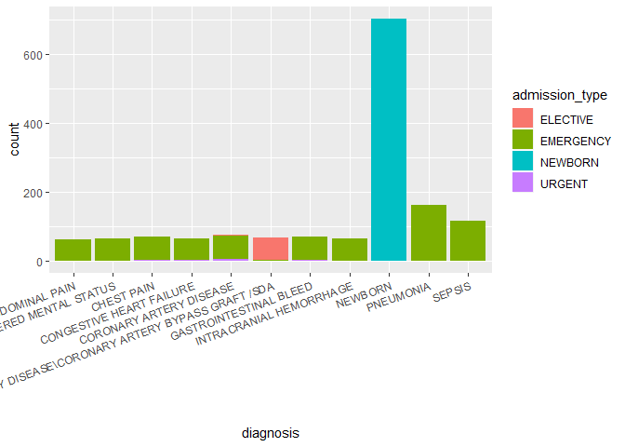
Top diagnoses
Newborn has the most diagnoses by far
Makes sense because newborn is a common diagnosis
Thousands of other possible diagnoses, but newborn can only mean one thing

Slide 11
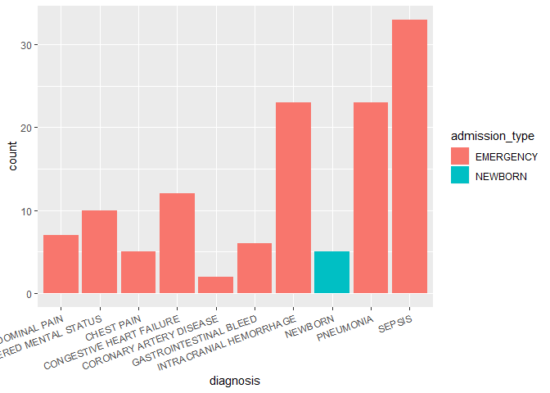
Top diagnoses resulting in death
Now we can analyze the diagnoses further to just including diagnoses that lead to death
The only top diagnoses that cause death occur only in Emergency and Newborn types, why?

Slide 12
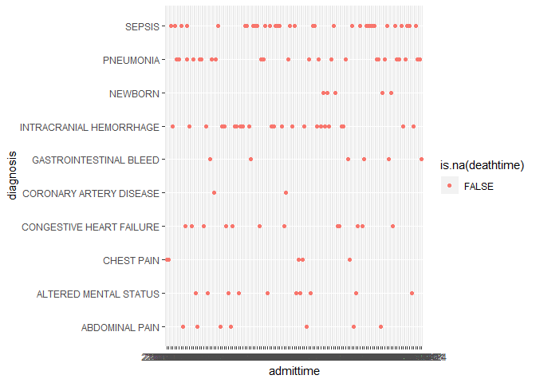
When do we diagnose?
Even though our admission time is as a string in the format YYYY-MM-DD we can still plot them and have them ordered lexicographically
By doing this, we can see how diagnoses are spread through the years

Slide 13
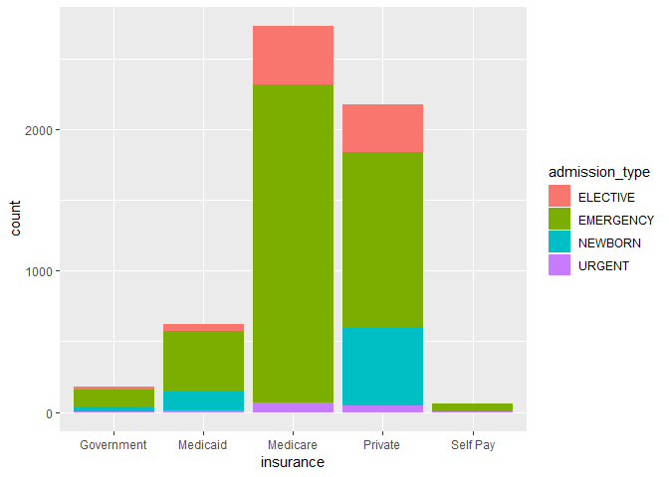
Who pays for you to go
We can clearly see the most admissions are for people on Medicare and private insurance
Unsurprisingly, most of these are made up of Emergency types
Interesting to note that Newborns do no occur in Medicare, but only in Private and Medicaid
Medicare is aimed for people aged >= 65

Slide 14
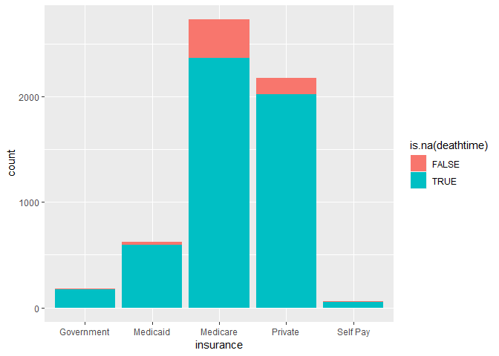
Deadly insurance
Unsurprisingly, Medicare has the most deaths of all insurances
Private vs Medicaid have similar ratios

Slide 15
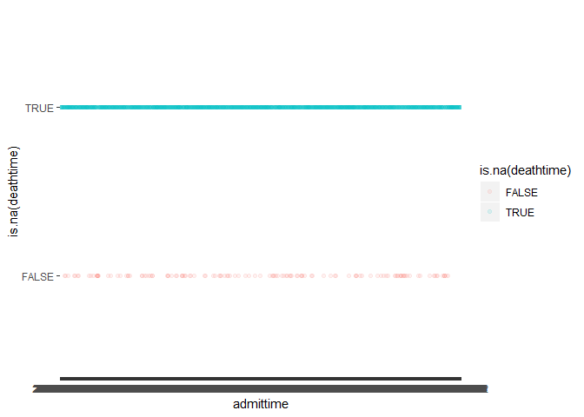
Seasonal deaths?
Again, as a final resort we can plot deathtimes against admission times with an opacity to see if there are certain times during the year that people tend to die

Slide 16
Further work
Expand more on the hypotheses of death caused by certain occurrences
Run statistical tests
Fisher test
Chi squared
Etc.
Touch up on some plots to make them more detailed

